Slide 1

A Brief Overview of the UNIX Command Line
AAFC Bioinformatics Conference and Workshop
September 19-20, 2019, Lethbridge, Alberta
Miles Buchwaldt
Biology Study Leader – Bioinformatics, Saskatoon RDC
19 Sept. 2019

Slide 2
Table of Contents
1. Basic Commands
2. Input & Output
3. The Environment
4. Non-standard Software
5. Regular Expressions
6. Scripting

Slide 4
What is the command line?
User interface, where a user can issues “commands” to the computer carry out various tasks.
Commands follow a strict format:
$ <command> <options> <arguments>
<command>: an executable file on the system
<options>: flags that change the default behavior of the program
<arguments>: information the program requires to carry out it’s task

Slide 5
UNIX 101 – Observe your Surroundings
Where am I?
What is around me?
How do I leave this place?

Slide 6
UNIX 101 – Change your Surroundings
Creating files:
Copying/Moving files:
Deleting files:
Reading file contents:

Slide 7

Input and Output
Text Streams
Redirection
Pipes

Slide 8
Text Streams
Text streams are blocks of characters, usually separated by newlines.
They are NOT the same thing as text files
Examples: STDIN, STDOUT, STDERR
Most commands take input from STDERR, output to STDOUT and if there are errors, send error information to STDERR

Slide 9
Redirection
These three text streams can be redirected (most often using files)
Redirect STDIN (read from file)
$ cat < text.txt
Redirect STDOUT
$ cat text.txt > another_text.txt
Redirect STDERR (and append
$ cat text.txt 2>> errors_text.txt

Slide 10

The Environment
Variables
Permissions
Important Directories

Slide 11
The “interpreter”, sh, bash, perl, python

Slide 12

Software
READ THE DOCUMENTATION! You can usually find it in INSTALL.txt, README.*, the GitHub page, the wiki, or with a google search.
Installation
Execution
Troubleshooting

Slide 13
Installing New Programs (via git)
Download a git repository
$ git clone https://github.com/lh3/bwa.git
Look out for special instructions that pertain to you
Likely a local installation!
./configure --prefix=~/bin

Slide 14
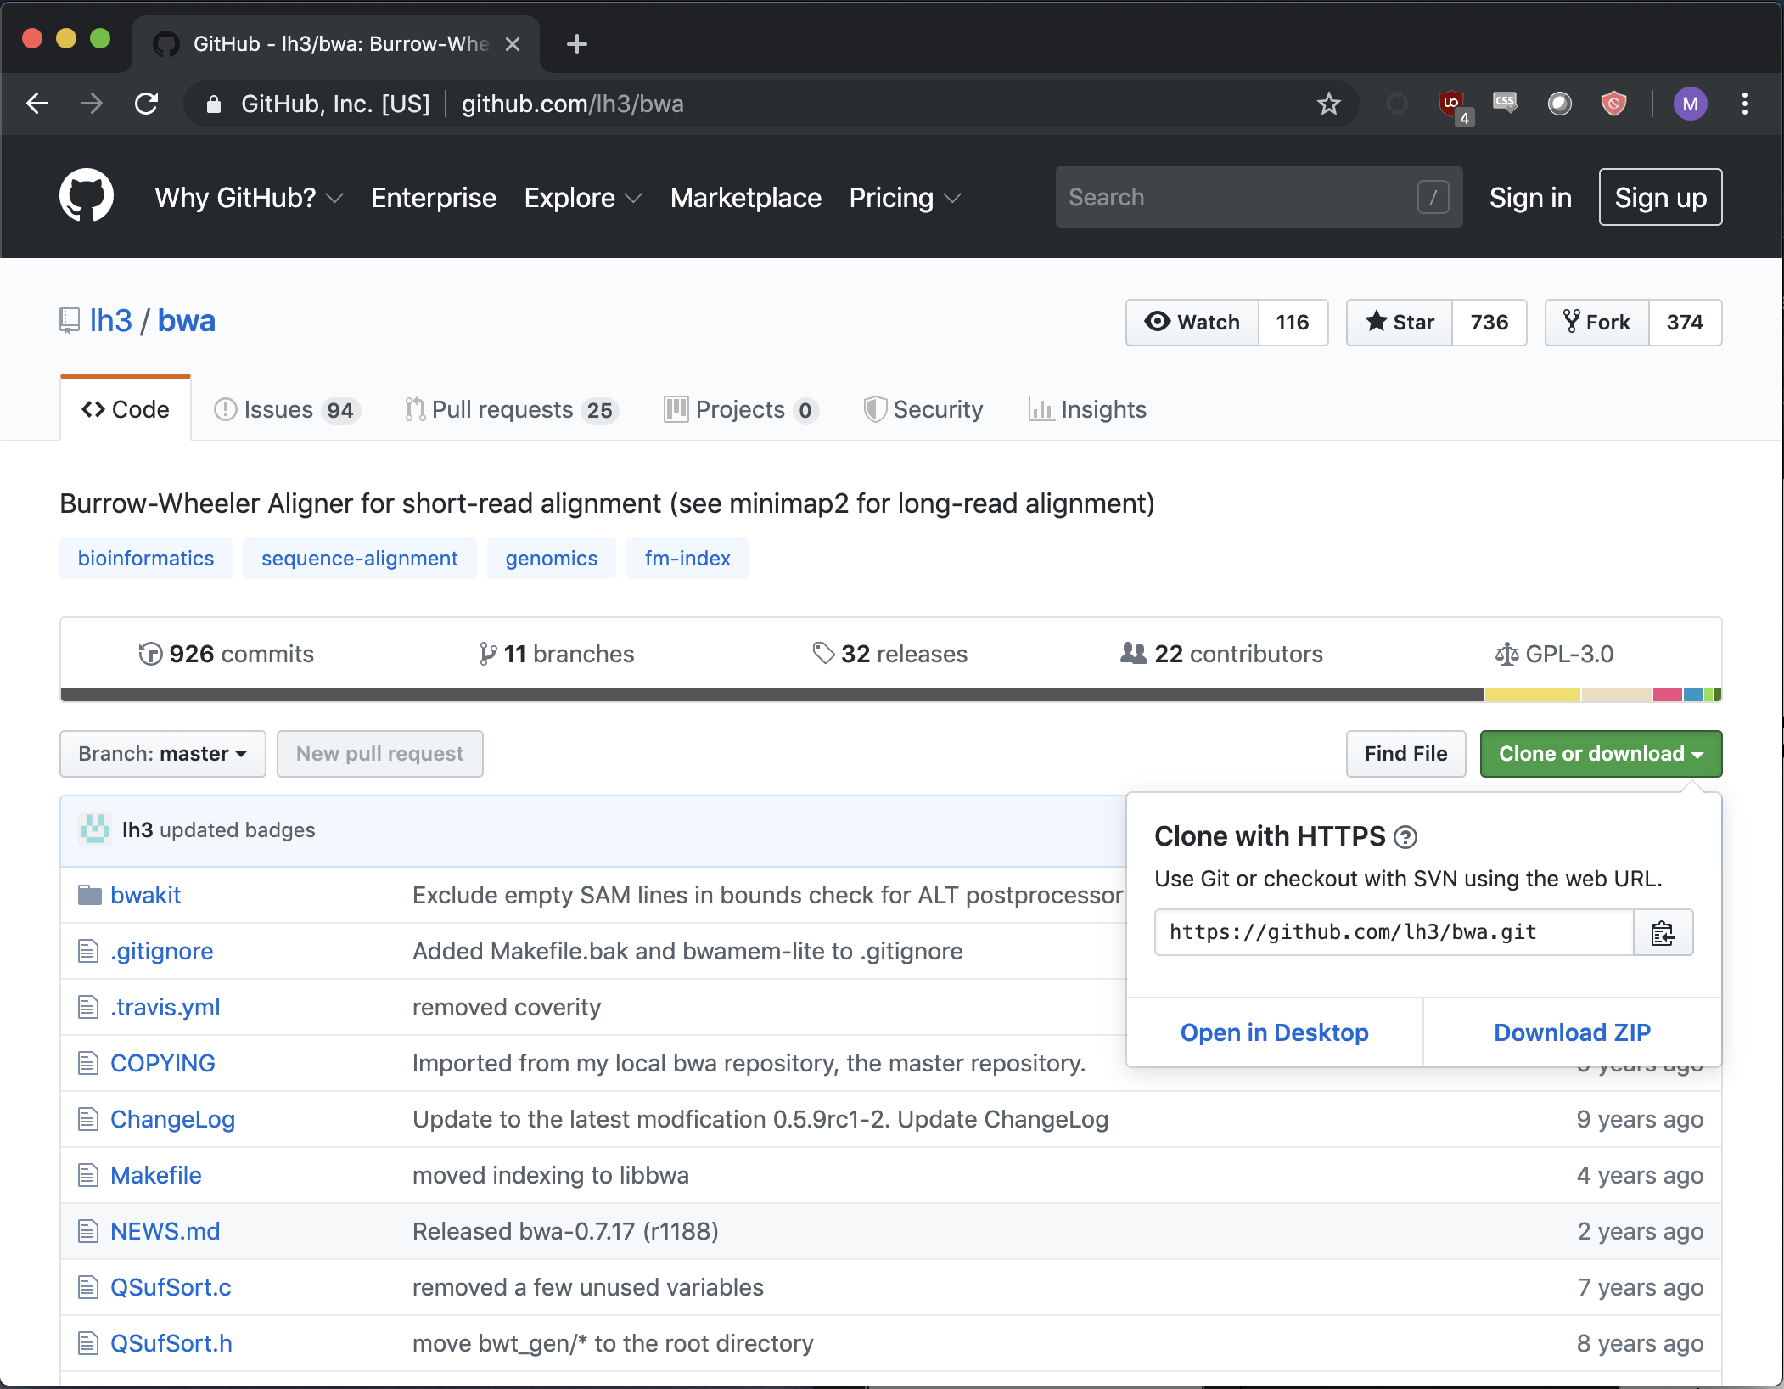
To get github link:
CLICK THIS

Slide 15
Running Software
Read Documentation: README.txt, README.md, etc.
$ <command> <options> <arguments>
$ java -jar /path/to/software.jar <options> <arguments>
$ perl script.pl <options> <arguments>
$
Make sure you understand what the command will do before you press enter!

Slide 16
Regular Expressions (shell)
Wildcards
Loops

Slide 17
Wildcards
Wildcards are special characters that have special meaning to the interpreter

